Slide 1

Market Analysis
Group Members
Anusha, Saira, Vishal, Ehsan, Aftab

Slide 2

Glarista
Shopping at glance

Slide 3
Our product
Glarista-shopping at glance.
Our mission is to modernize the current shopping system using tool of technology.

Slide 4

Market Segmentation
1.2 Million
Sukkur city
500,000
Female 45%
3,50000
16-40 Age 70%
1,40000
Income 40%
84000
Educated 60%
42000
Buy 50%
11000
Likes online shopping

Slide 5
Marketing Schedule
Medium | Time Frame | Frequency | Cost
Bill Boards | 1 Week | 2*7 | 50,000
Banners | 3 Months | 10*90 | 20,000
Social Media | 2 Months | 6*60 | 360,00
Live platform | 3 days | 5*3 | 20,000

Slide 6
Sales Forecast
Jan | Feb | March | April | May | June | July | August | Sept | Oct | Nov | Dec
600,000 | 500,000 | 50.0000 | 550,000 | 600,000 | 800,000 | 100,000 | 900,000 | 600,000 | 100,000 | 100,000 | 900,000

Slide 7
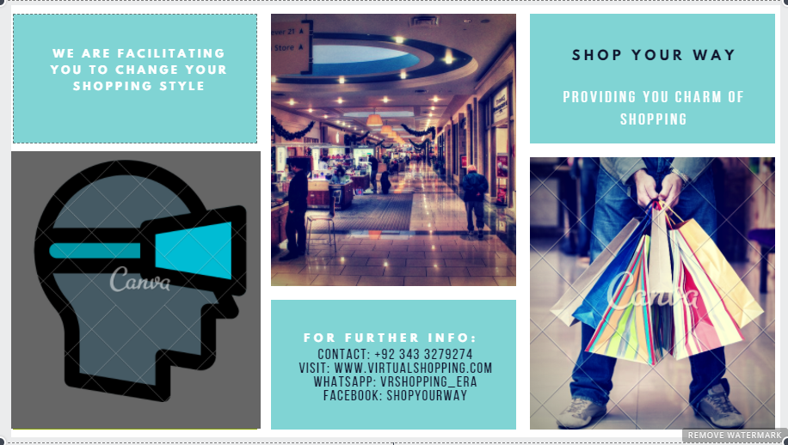
Brochure

Slide 8

Banner

Slide 9
Thank You

